Slide 1
CRYPTOGRAPHY AND NETWORK SECURITY CHAPTER 3: Public key cryptography and key Management
PROF.POORNIMA R D
ASSISTANT PROFESSOR
DEPT. OF CSE
DR.AIT

Slide 2
TABLE OF CONTENTS
Principles of Public Key Cryptography
RSA Algorithm
Key Management
Diffie Hellman Key Exchange
Elliptic Curve Cryptography

Slide 3
Principles of Public key Cryptosystems
Asymmetric algorithms rely on one key for encryption and a different but related key for decryption. These algorithms have the following important characteristic:
It is computationally infeasible to determine the decryption key given only knowledge of the cryptographic algorithm and the encryption key. In addition, some algorithms, such as RSA, also exhibit the following characteristic.
Either of the two related keys can be used for encryption, with the other used for decryption. A public-key encryption scheme has six ingredients.
Plaintext: This is the readable message or data that is fed into the algorithm as input.
Encryption algorithm: The encryption algorithm performs various transformations on the plaintext.

Slide 4
Principles of Public key Cryptosystems
Public and private keys: This is a pair of keys that have been selected so that if one is used for encryption, the other is used for decryption. The exact transformations performed by the algorithm depend on the public or private key that is provided as input.
■ Ciphertext: This is the encrypted message produced as output. It depends on the plaintext and the key. For a given message, two different keys will produce two different ciphertexts.
Decryption algorithm: This algorithm accepts the ciphertext and the matching key and produces the original plaintext. The essential steps are the following.
1. Each user generates a pair of keys to be used for the encryption and decryption of messages.
2. Each user places one of the two keys in a public register or other accessible file. This is the public key. The companion key is kept private. As Figure 9.1a suggests, each user maintains a collection of public keys obtained from others.
3. If Bob wishes to send a confidential message to Alice, Bob encrypts the message using Alice’s public key.
4. When Alice receives the message, she decrypts it using her private key. No other recipient can decrypt the message because only Alice knows Alice’s private key.

Slide 5
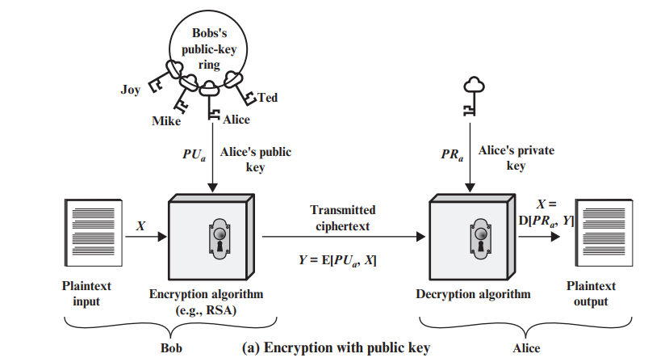
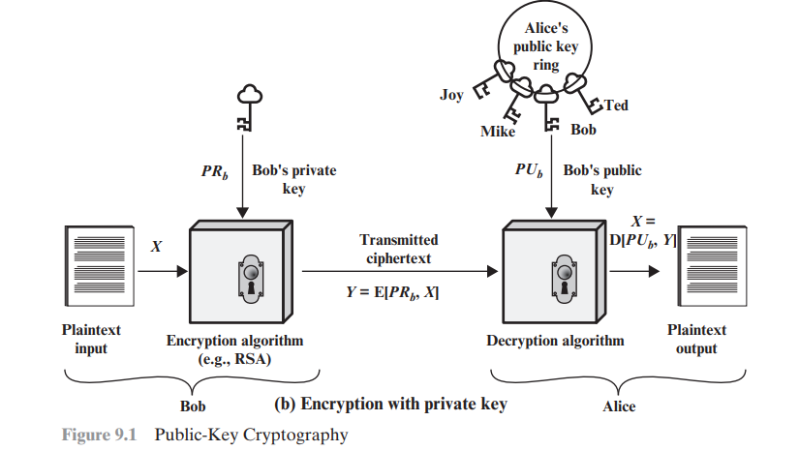

Slide 6
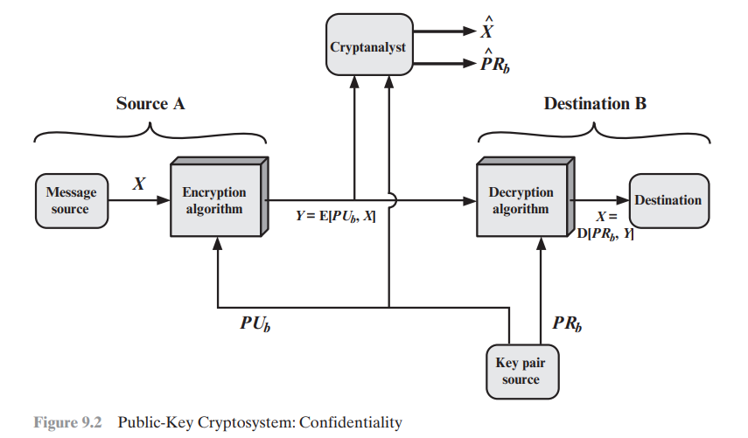
Let us take a closer look at the essential elements of a public-key encryption scheme, using Figure 9.2 (compare with Figure 3.2).
There is some source A that produces a message in plaintext, X = [X1, X2, c , XM]. The M elements of X are letters in some finite alphabet. The message is intended for destination B. B generates a related pair of keys: a public key, PUb, and a private key, PRb. PRb is known only to B, whereas PUb is publicly available and therefore accessible by A.
With the message X and the encryption key PUb as input, A forms the ciphertext
Y = [Y1, Y2, c , YN]:
Y = E(PUb, X)
The intended receiver, in possession of the matching private key, is able to invert the transformation: X = D(PRb,Y)

Slide 7
An adversary, observing Y and having access to PUb, but not having access to PRb or X, must attempt to recover X and/or PRb. It is assumed that the adversary does have knowledge of the encryption (E) and decryption (D) algorithms. If the adversary is interested only in this particular message, then the focus of effort is to recover X by generating a plaintext estimate Xn . Often, however, the adversary is interested in being able to read future messages as well, in which case an attempt is made to recover PRb by generating an estimate PRn b.

Slide 8
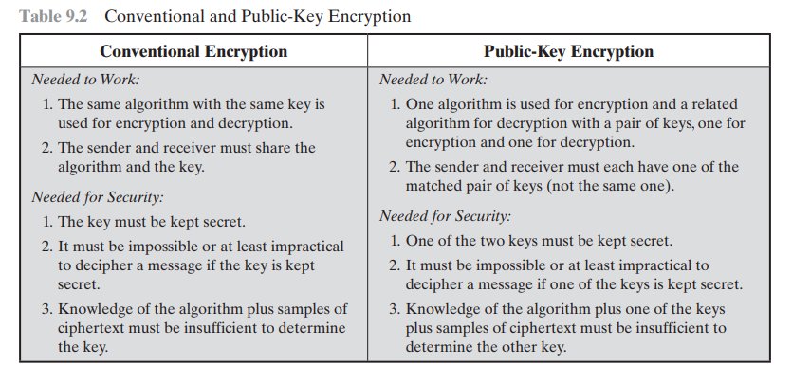

Slide 9
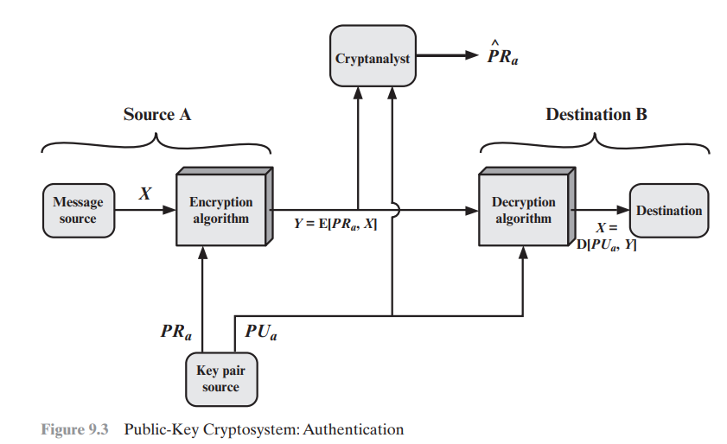
Figure 9.2 provides confidentiality, Figures 9.1b and 9.3 show the use of public-key encryption to provide authentication:
Y = E(PRa,X)
X = D(PUa,Y)
In this case, A prepares a message to B and encrypts it using A’s private key before transmitting it. B can decrypt the message using A’s public key. Because the message was encrypted using A’s private key, only A could have prepared the message. Therefore, the entire encrypted message serves as a digital signature. In addition, it is impossible to alter the message without access to A’s private key, so the message is authenticated both in terms of source and in terms of data integrity.

Slide 10
In the preceding scheme, the entire message is encrypted, which, although validating both author and contents, requires a great deal of storage.
Each document must be kept in plaintext to be used for practical purposes. A copy also must be stored in ciphertext so that the origin and contents can be verified in case of a dispute.
A more efficient way of achieving the same results is to encrypt a small block of bits that is a function of the document. Such a block, called an authenticator, must have the property that it is infeasible to change the document without changing the authenticator.
If the authenticator is encrypted with the sender’s private key, it serves as a signature that verifies origin, content, and sequencing.

Slide 11
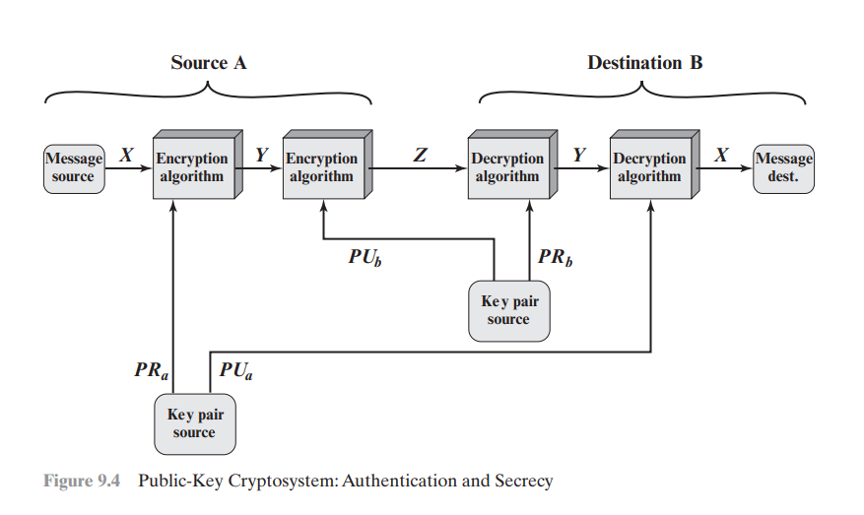

Slide 12
Even in the case of complete encryption, as shown in Figure 9.3, there is no protection of confidentiality because any observer can decrypt the message by using the sender’s public key.
It is, however, possible to provide both the authentication function and confidentiality by a double use of the public-key scheme (Figure 9.4):
Z = E(PUb, E(PRa,X))
X = D(PUa, D(PRb,Z))
In this case, we begin as before by encrypting a message, using the sender’s private key. This provides the digital signature. Next, we encrypt again, using the receiver’s public key. The final ciphertext can be decrypted only by the intended receiver, who alone has the matching private key. Thus, confidentiality is provided. The disadvantage of this approach is that the public-key algorithm, which is complex, must be exercised four times rather than two in each communication.

Slide 13
Applications of Public-key Cryptosystem
Encryption/decryption: The sender encrypts a message with the recipient’s public key, and the recipient decrypts the message with the recipient’s private key.
Digital signature: The sender “signs” a message with its private key. Signing is achieved by a cryptographic algorithm applied to the message or to a small block of data that is a function of the message.
Key exchange: Two sides cooperate to exchange a session key, which is a secret key for symmetric encryption generated for use for a particular transaction (or session) and valid for a short period of time. Several different approaches are possible, involving the private key(s) of one or both parties;

Slide 14
Requirements of Public-Key Cryptosystem
The cryptosystem illustrated in Figures 9.2 through 9.4 depends on a cryptographic algorithm based on two related keys. Diffie and Hellman postulated this system without demonstrating that such algorithms exist. However, they did lay out the conditions that such algorithms must fulfill [DIFF76b].
It is computationally easy for a party B to generate a key pair (public key PUb, private key PRb).
It is computationally easy for a sender A, knowing the public key and the message to be encrypted, M, to generate the corresponding ciphertext: C = E(PUb, M)
It is computationally easy for the receiver B to decrypt the resulting ciphertext using the private key to recover the original message: M = D(PRb, C) = D[PRb, E(PUb, M)]
It is computationally infeasible for an adversary, knowing the public key, PUb, to determine the private key, PRb.
It is computationally infeasible for an adversary, knowing the public key, PUb, and a ciphertext, C, to recover the original message, M. We can add a sixth requirement that, although useful, is not necessary for all public-key applications:
The two keys can be applied in either order: M = D[PUb, E(PRb, M)] = D[PRb, E(PUb, M)]

Slide 15
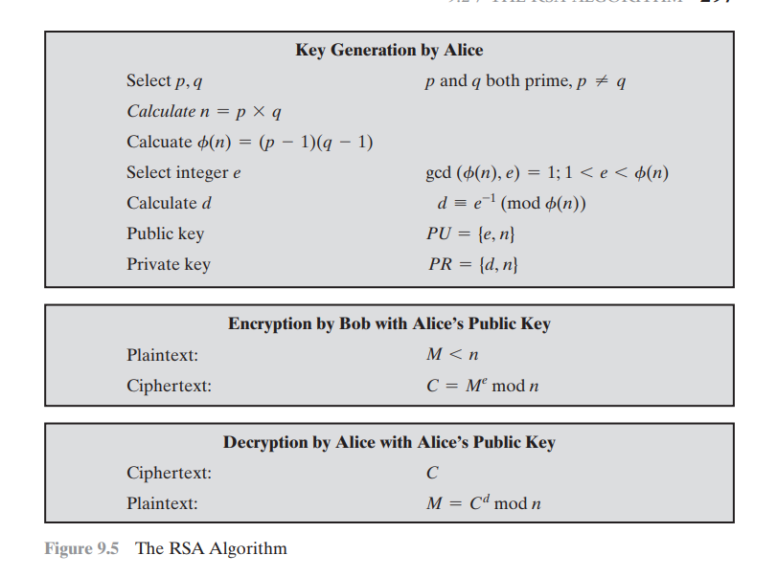
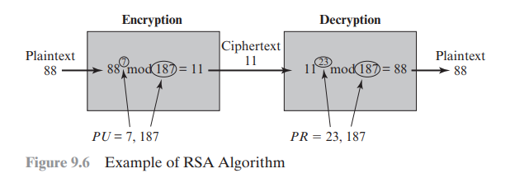
RSA Algorithm

Slide 16
RSA Algorithm
RSA makes use of an expression with exponentials. Plaintext is encrypted in blocks, with each block having a binary value less than some number n. That is, the block size must be less than or equal to log2(n) + 1; in practice, the block size is i bits, where 2i 6 n … 2i+1 . Encryption and decryption are of the following form, for some plaintext block M and ciphertext block C.
C = Me mod n
M = Cd mod n = (Me )
d mod n = Med mod n
Both sender and receiver must know the value of n. The sender knows the value of e, and only the receiver knows the value of d. Thus, this is a publickey encryption algorithm with a public key of PU = {e, n} and a private key of PR = {d, n}. For this algorithm to be satisfactory for public-key encryption, the following requirements must be met.
1. It is possible to find values of e, d, and n such that Med mod n = M for all M 6 n.
2. It is relatively easy to calculate Me mod n and Cd mod n for all values of M 6 n.
3. It is infeasible to determine d given e and n.

Slide 17
The Security of RSA
Five possible approaches to attacking the RSA algorithm are
Brute force: This involves trying all possible private keys.
Mathematical attacks: There are several approaches, all equivalent in effort to factoring the product of two primes.
Timing attacks: These depend on the running time of the decryption algorithm.
Hardware fault-based attack: This involves inducing hardware faults in the processor that is generating digital signatures.
Chosen ciphertext attacks: This type of attack exploits properties of the RSA algorithm.

Slide 18
Key Management
One of the major roles of public-key encryption has been to address the problem of key distribution. There are actually two distinct aspects to the use of public-key cryptography in this regard:
The distribution of public keys
The use of public-key encryption to distribute secret keys.
Distribution of Public Keys Several techniques have been proposed for the distribution of public keys. Virtually all these proposals can be grouped into the following general schemes:
Public announcement
Publicly available directory
Public-key authority
Public-key certificates

Slide 19
Public Announcement of Public Keys
On the face of it, the point of public-key encryption is that the public key is public. Thus, if there is some broadly accepted public-key algorithm, such as RSA, any participant can send his or her public key to any other participant or broadcast the key to the community at large (Figure 10.1). For example, because of the growing popularity of PGP (pretty good privacy, discussed in Chapter 15), which makes use of RSA, many PGP users have adopted the practice of appending their public key to messages that they send to public forums, such as USENET newsgroups and Internet mailing lists.
Although this approach is convenient, it has a major weakness. Anyone can forge such a public announcement. That is, some user could pretend to be user A and send a public key to another participant or broadcast such a public key. Until such time as user A discovers the forgery and alerts other participants, the forger is able to read all encrypted messages intended for A and can use the forged keys for authentication

Slide 20
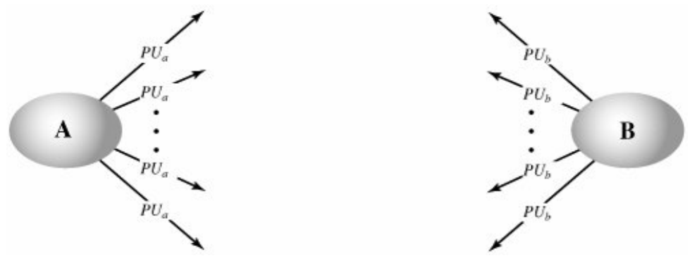
Public Announcement of Public Keys

Slide 21
Publicly Available Directory
A greater degree of security can be achieved by maintaining a publicly available dynamic directory of public keys. Maintenance and distribution of the public directory would have to be the responsibility of some trusted entity or organization (Figure 10.2). Such a scheme would include the following elements:
1. The authority maintains a directory with a {name, public key} entry for each participant.
2. Each participant registers a public key with the directory authority. Registration would have to be in person or by some form of secure authenticated communication.
3. A participant may replace the existing key with a new one at any time, either because of the desire to replace a public key that has already been used for a large amount of data, or because the corresponding private key has been compromised in some way.
4. Participants could also access the directory electronically. For this purpose, secure, authenticated communication from the authority to the participant is mandatory.

Slide 22
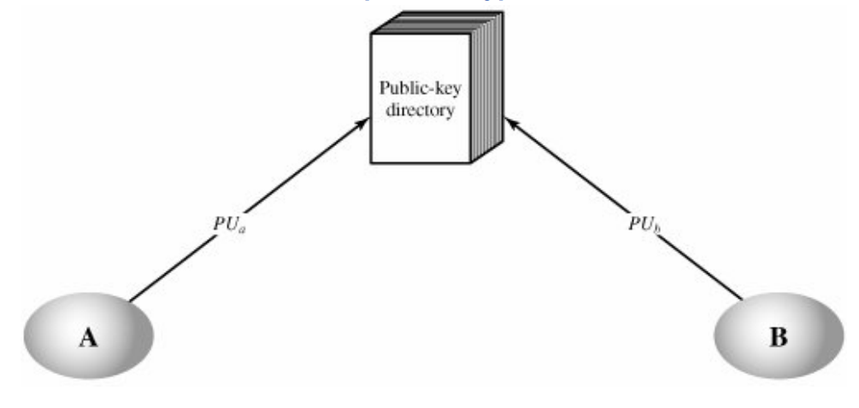
Public-key Publication

Slide 23
Public Key Authority
Stronger security for public-key distribution can be achieved by providing tighter control over the distribution of public keys from the directory. A typical scenario is illustrated in Figure 10.3, which is based on a figure in [POPE79]. As before, the scenario assumes that a central authority maintains a dynamic directory of public keys of all participants. In addition, each participant reliably knows a public key for the authority, with only the authority knowing the corresponding private key. The following steps (matched by number to Figure 10.3) occur:
1. A sends a timestamped message to the public-key authority containing a request for the current public key of B.
2. The authority responds with a message that is encrypted using the authority's private key, PRauth Thus, A is able to decrypt the message using the authority's public key. Therefore, A is assured that the message originated with the authority. The message includes the following:
● B's public key, PUb which A can use to encrypt messages destined for B
● The original request, to enable A to match this response with the corresponding earlier request and to verify that the original request was not altered before reception by the authority
The original timestamp, so A can determine that this is not an old message from the authority containing a key other than B's current public key

Slide 24
Public Key Authority
3. A stores B's public key and also uses it to encrypt a message to B containing an identifier of A (IDA) and a nonce (N1), which is used to identify this transaction uniquely.
4: B retrieves A's public key from the authority in the same manner as A retrieved B's public key.
5: At this point, public keys have been securely delivered to A and B, and they may begin their protected exchange. However, two additional steps are desirable:
6. B sends a message to A encrypted with PU a and containing A's nonce (N1) as well as a new nonce generated by B (N2) Because only B could have decrypted message (3), the presence of N1 in message (6) assures A that the correspondent is B.
7. A returns N2, encrypted using B's public key, to assure B that its correspondent is A.

Slide 25
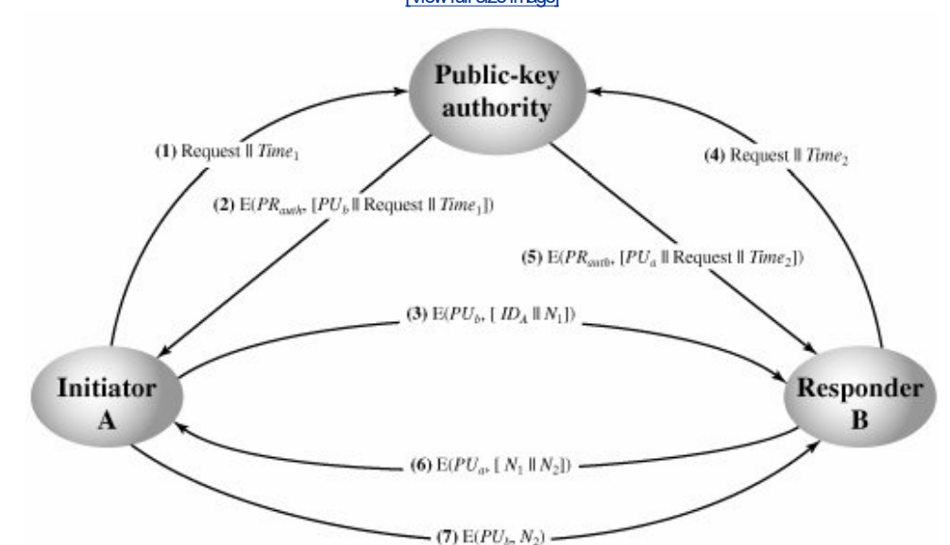
Public Key-Distribution Scenario

Slide 26
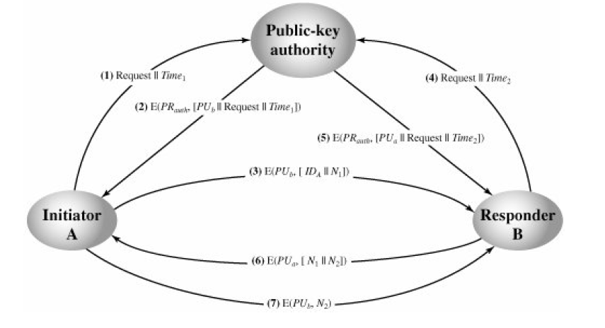
Public-Key Distribution Scenario

Slide 27
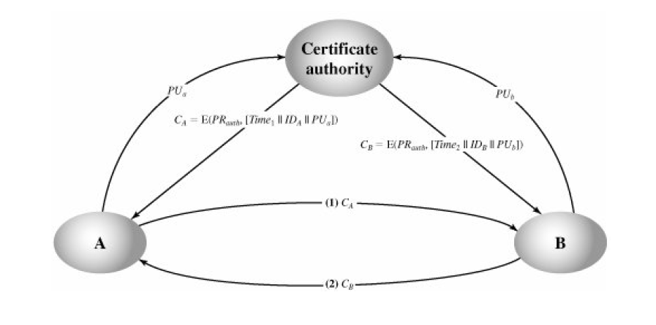
Exchange of Public-Key Certificates

Slide 28
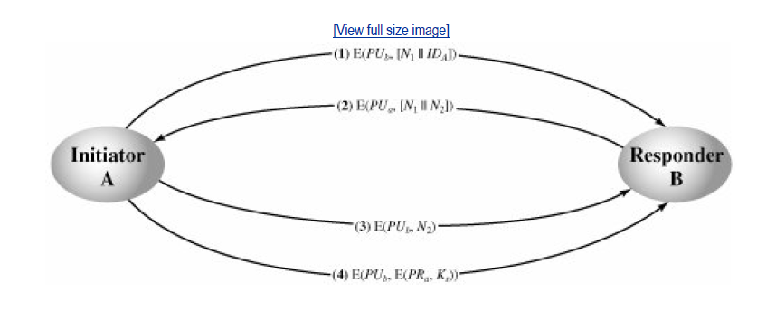
Public-Key Distribution of Secret Keys

Slide 29
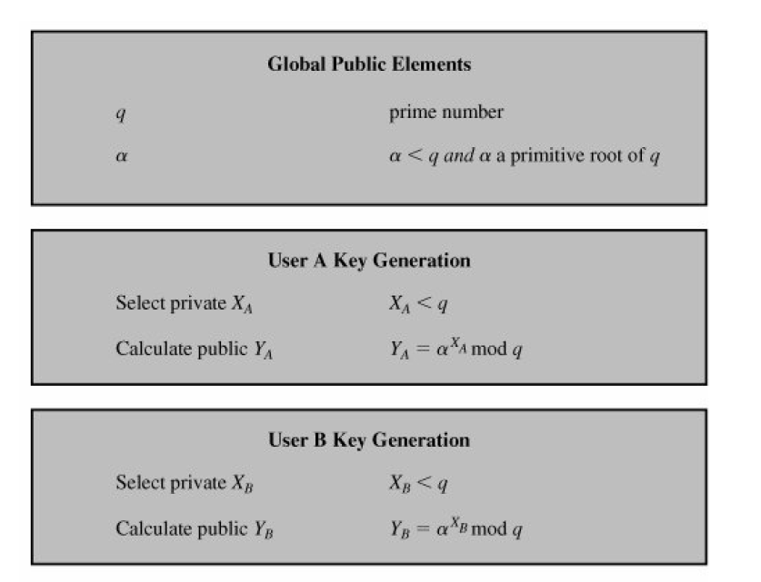
The Diffie-Hellman Key Exchange Algorithm

Slide 30

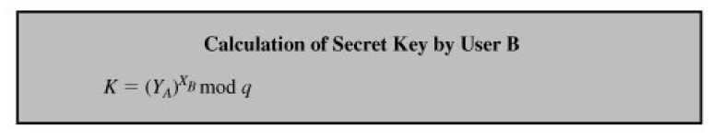

Slide 31
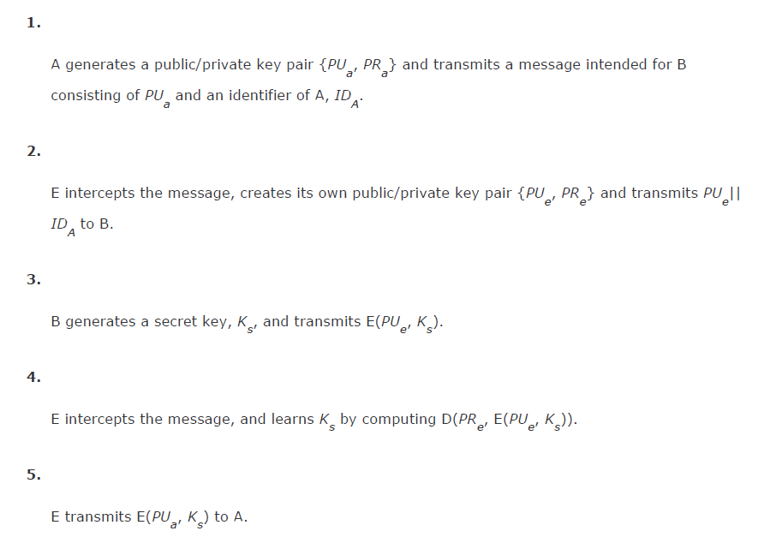
Man-in-the-middle attack

Slide 32
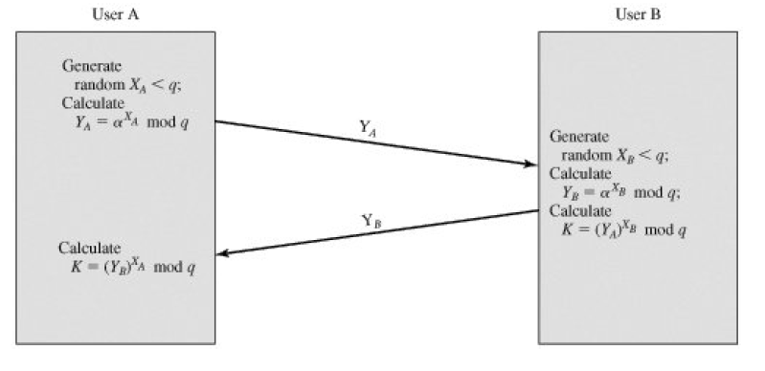
The Deffie-Hellman Key Exchange

Slide 33
Man-in-the-middle attack
The protocol depicted in Figure 10.8 is insecure against a man-in-the-middle attack. Suppose Alice and
Bob wish to exchange keys, and Darth is the adversary. The attack proceeds as follows:
Darth prepares for the attack by generating two random private keys XD1 and XD2 and then
computing the corresponding public keys YD1 and YD2.
2. Alice transmits YA to Bob.
3. Darth intercepts YA and transmits YD1 to Bob. Darth also calculates K2 = (YA)XD2 mod q.
4. Bob receives YD1 and calculates K1 = (YD1)X
E mod q.
5. Bob transmits XA to Alice.
6. Darth intercepts XA and transmits YD2 to Alice. Darth calculates K1 = (YB)X
D1 mod q.

Slide 34
7. Alice receives YD2 and calculates K2 = (YD2)X
A mod q.
At this point, Bob and Alice think that they share a secret key, but instead Bob and Darth share secret
key K1 and Alice and Darth share secret key K2. All future communication between Bob and Alice is
compromised in the following way:
1. Alice sends an encrypted message M: E(K2, M).
2. Darth intercepts the encrypted message and decrypts it, to recover M.
3. Darth sends Bob E(K1, M) or E(K1, M'), where M' is any message. In the first case, Darth simply wants to eavesdrop on the communication without altering it. In the second case, Darth wants to modify the message going to Bob.
The key exchange protocol is vulnerable to such an attack because it does not authenticate the
participants.

Slide 35
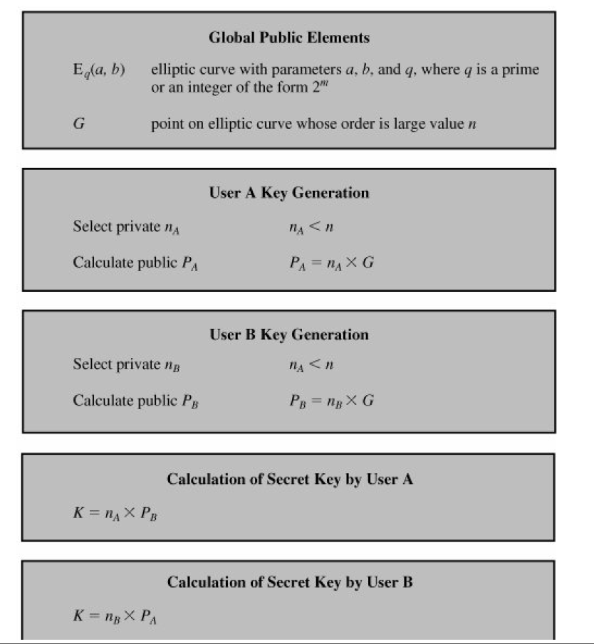
ECC Deffie-Hellman Key Exchange

Slide 36
